Slide 1
Into the Tidyverse Session 5
Course written by Tim Hargreaves

Slide 2
Saving Dataframes

Slide 3
Saving a dataframe
We can save a copy of a dataframe as a CSV file to be read in again when needed
We can do this using the write_csv() function from readr
This takes two main arguments:
The first is the dataframe you wish to save
second is a path for where to save the file (e.g. 'data/my_data.csv’ )
~By default, this will overwrite any existing file though you can specify append = TRUE to instead append the contents~

Slide 4
Saving a dataframe
write_csv( dataframe , ‘file name/ pathway’, append=TRUE)

Slide 5
Exercises to try
head(dataframe)
write_csv( dataframe ,‘file name/ pathway’, append=TRUE)
Write the head of the iris dataset to a CSV file called ‘iris.csv’
2) Now, append the tail of the iris dataset to the same CSV file

Slide 6
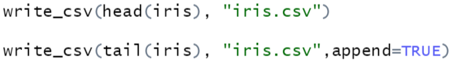
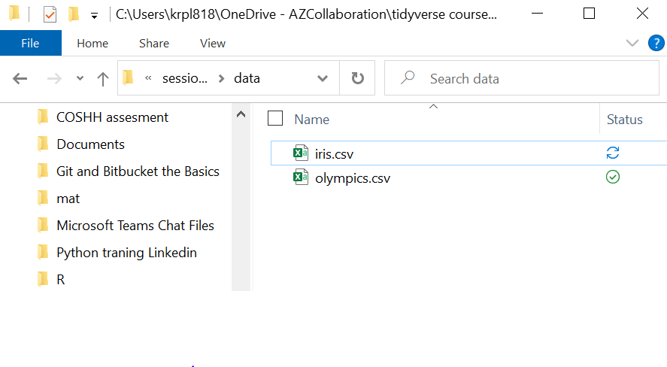
Answers
1)
2)

Slide 7
Geometries

Slide 8
Types of geometries
Now that we have an idea about how stats in ggplot2 behave, we can introduce some more geometries:
One variable - geom_area(), geom_density(), geom_freqpoly(), geom_histogram(), geom_bar()
Two variables (both continuous) - geom_label(), geom_text(), geom_rug(),geom_scatter()
Two variables (one discrete) - geom_col(), geom_boxplot(), geom_violin()
Two variables (both discrete) - geom_count()
You can find which aesthetics these geometries require and accept by looking at their help pages

Slide 9
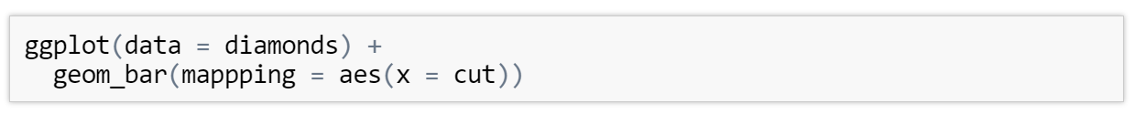
Bar charts
We can also use ggplot to create bar charts using the geom_bar() geometry
Here we create a bar chart of the cuts in the diamonds dataframe

Slide 10
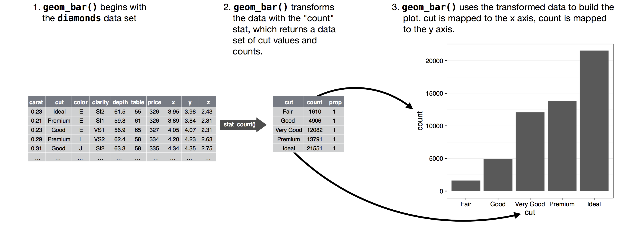
Bar chart
On the x-axis we have a variable we recognise, cut, but on the y-axis we have a variable, count, that didn't appear anywhere in the original dataset
it counts the number of cases at each x position (e.g the number of diamonds with good cuts is ~ 5000)

Slide 11
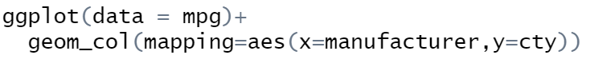
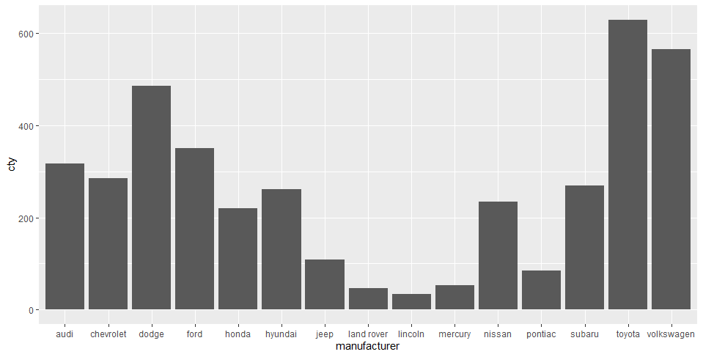
Bar chart
If we want to plot a bar chart using 2 variables from our dataset we can use geom_col() instead. This just uses the y value from the column we get to total of the y values for each group

Slide 12
Exercise to try
Create a bar chart using the manufacturer column of the mpg dataset fill by manufacturer and save this file using export.
BONUS – see what happens when you add + coord_flip()
ggplot(data = dataframe)+
geom_bar(mapping = aes(x = column_1 , fill= column_2 )) + coord_flip()

Slide 13
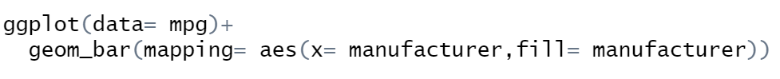
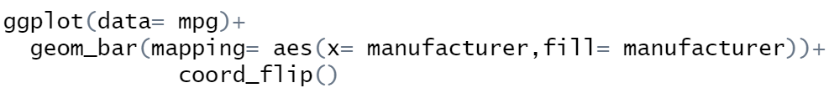
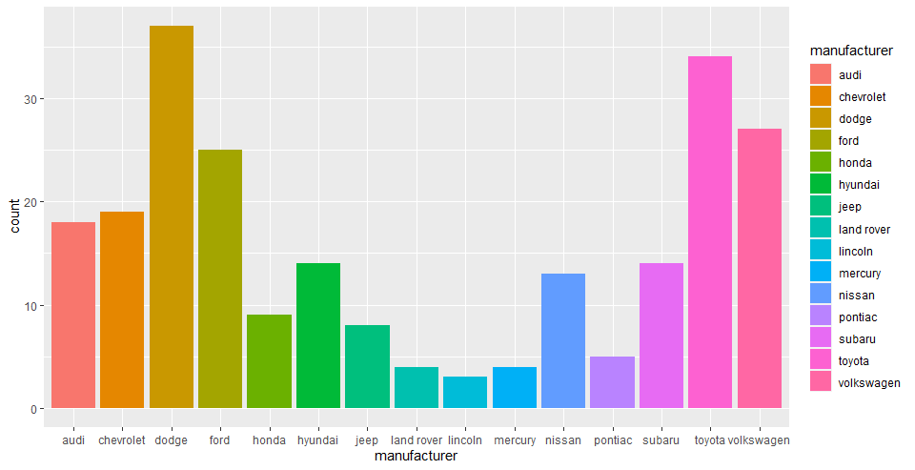
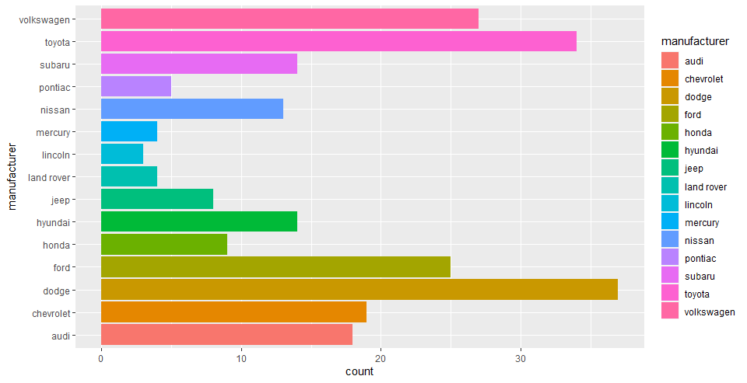
Answer

Slide 14
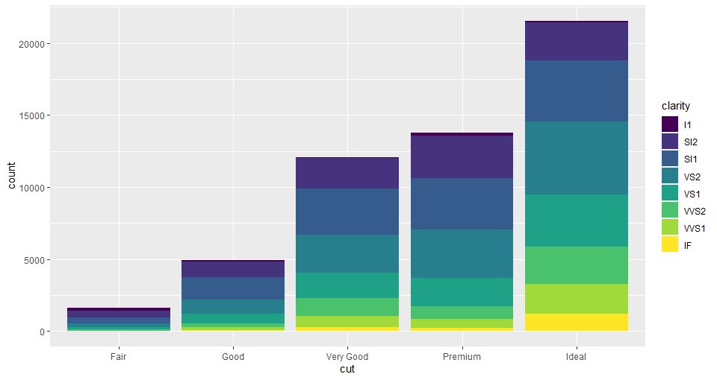
Stacked Bars
What happens when we map the fill aesthetic to one other than that being using for the x axis ?
We end up with a stacked bar chart

Slide 15
Position settings

Slide 16
Position setting
This is because the default value of the position parameter for geom_bar is “stack”
If we didn't like this behaviour we have “identity”, “dodge”, and “fill” to choose from
“identity” will place each object exactly where it would normally fall in the graph. This will cause bars to overlap and so this should only be used with alpha set to a low value or with fill = NA and an outline colour
“dodge” places overlapping objects side-by-side. This makes it easy to compare individual observations but obscures the group behaviour
“fill” works like “stack” but makes each set of stacked bars the same height. This makes it easier to compare the breakdown of each group

Slide 17
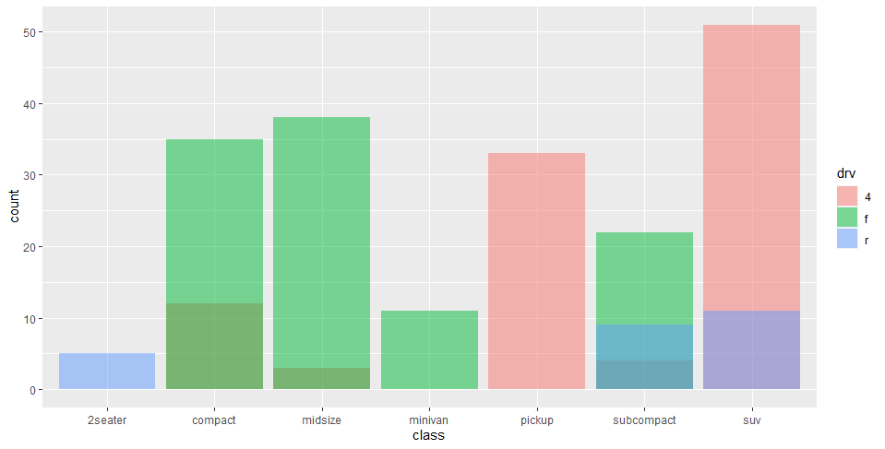
Position Identity

Slide 18
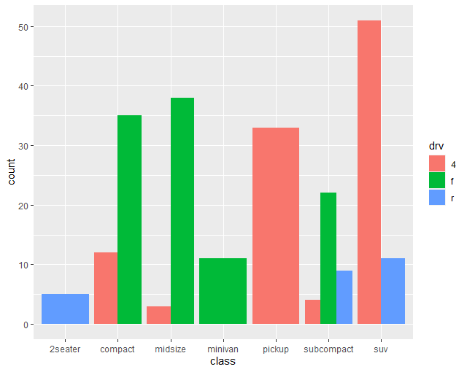
Position Dodge

Slide 19
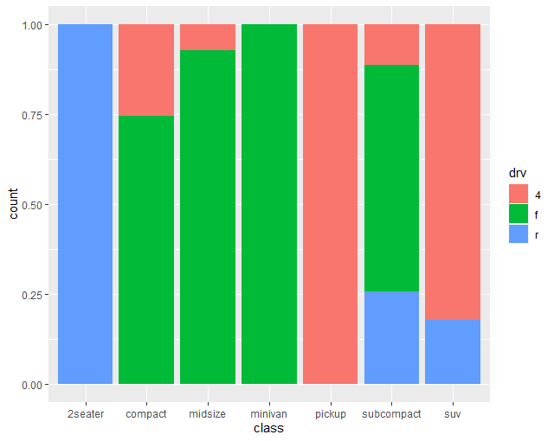
Position Fill

Slide 20
Exercise to try
Create a bar chart using cut for our x axis diamonds dataset filled by clarity. Set the position as "dodge"
ggplot(data = dataframe)+
geom_bar(mapping = aes(x = column , fill= column),
position= “……”)

Slide 21
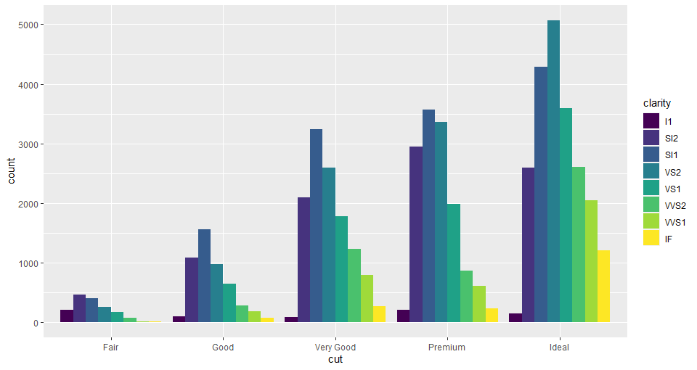
Answer

Slide 22
Coordinate Systems

Slide 23
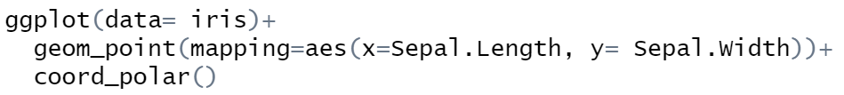
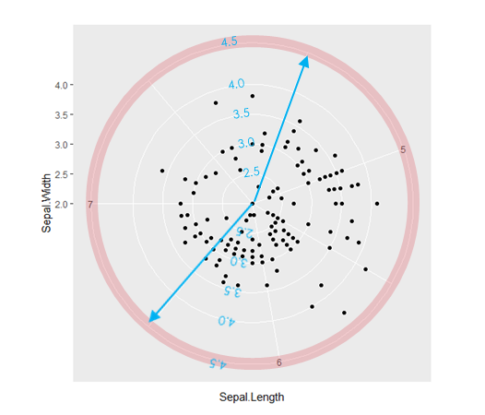
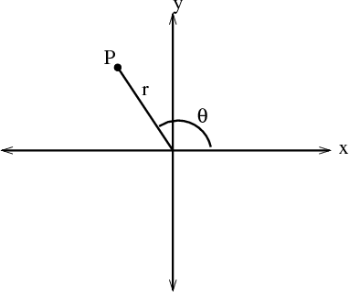
Polar Coordinates
You can use coord_polar() which transforms (x,y) → (r, θ) in polar coordinates
r
θ

Slide 24
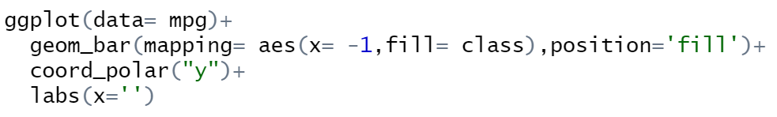
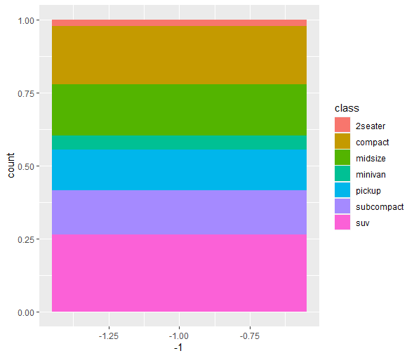
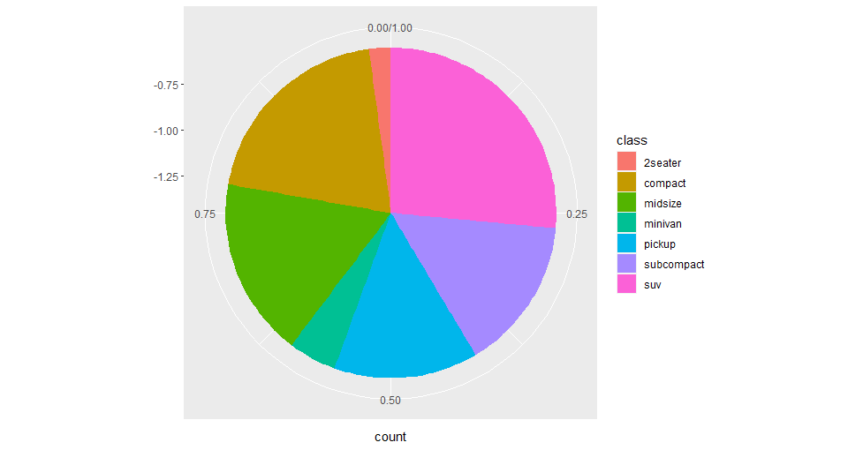
Pie Charts

Slide 25
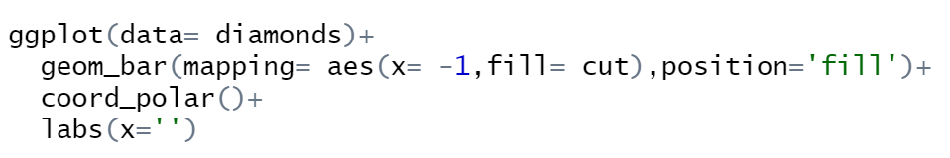
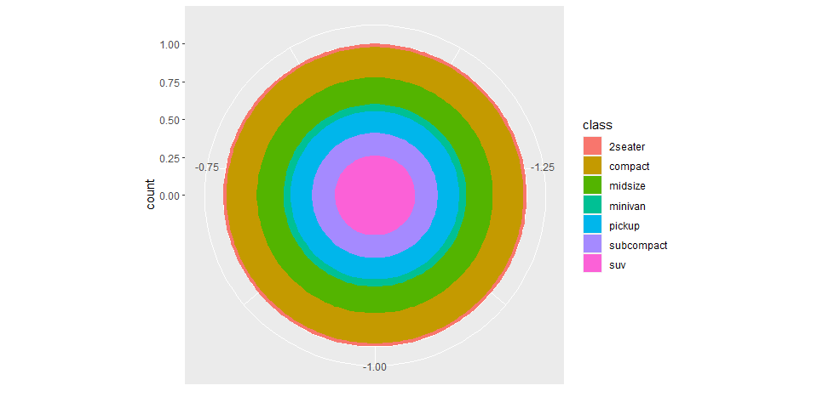
Why use coord_polar(“y”)
The default is that x is plotted around the circumference as x=θ and y is plotted as the radius as y=r
This isn’t going to give us a pie chart though
We need to swap this so y=θ (plotted around the circumference) and x=r (radius)

Slide 26
Exercise to try
Create a pie chart of any appropriate variable you wish from the diamonds dataset
ggplot(data = dataframe)+
geom_bar(mapping = aes(x = -1 , fill= column ),position='fill') + coord_polar(“y”)

Slide 27
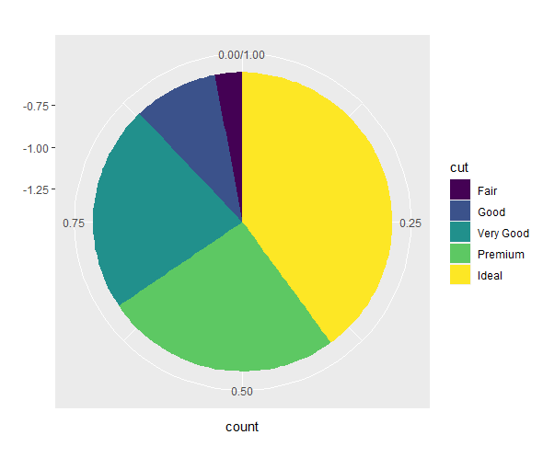
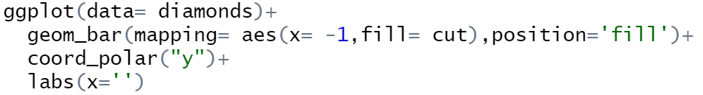
Answers

Slide 28
Bonus Questions

Slide 29
Lets look at 3D graphs !
Why 3D:
If we have 2 or more predictive variables 3D plots are really good to see all the variables interactions
If a dataset has both positive and negative effects from different continuous variables we can loose sight of our relationships when just in 2D
We’ll be using the package rgl and car to complete our 3D graphs so go ahead and install.packages(‘package’) and load those packages using library(‘package’)
The car package has a built in dataset called Soils which we will be using for the plot

Slide 30
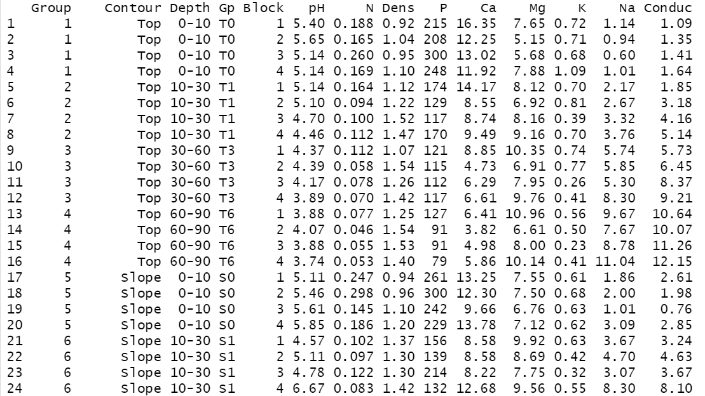
Soil Dataset
Load in the Soils dataset and assign it to an object called soils_df

Slide 31
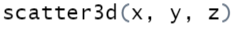
3D plot
We firstly need to assign 3 variables x – sodium content , y- soil pH, and z – conductivity
Now we can create our 3D scatterplot:

Slide 32
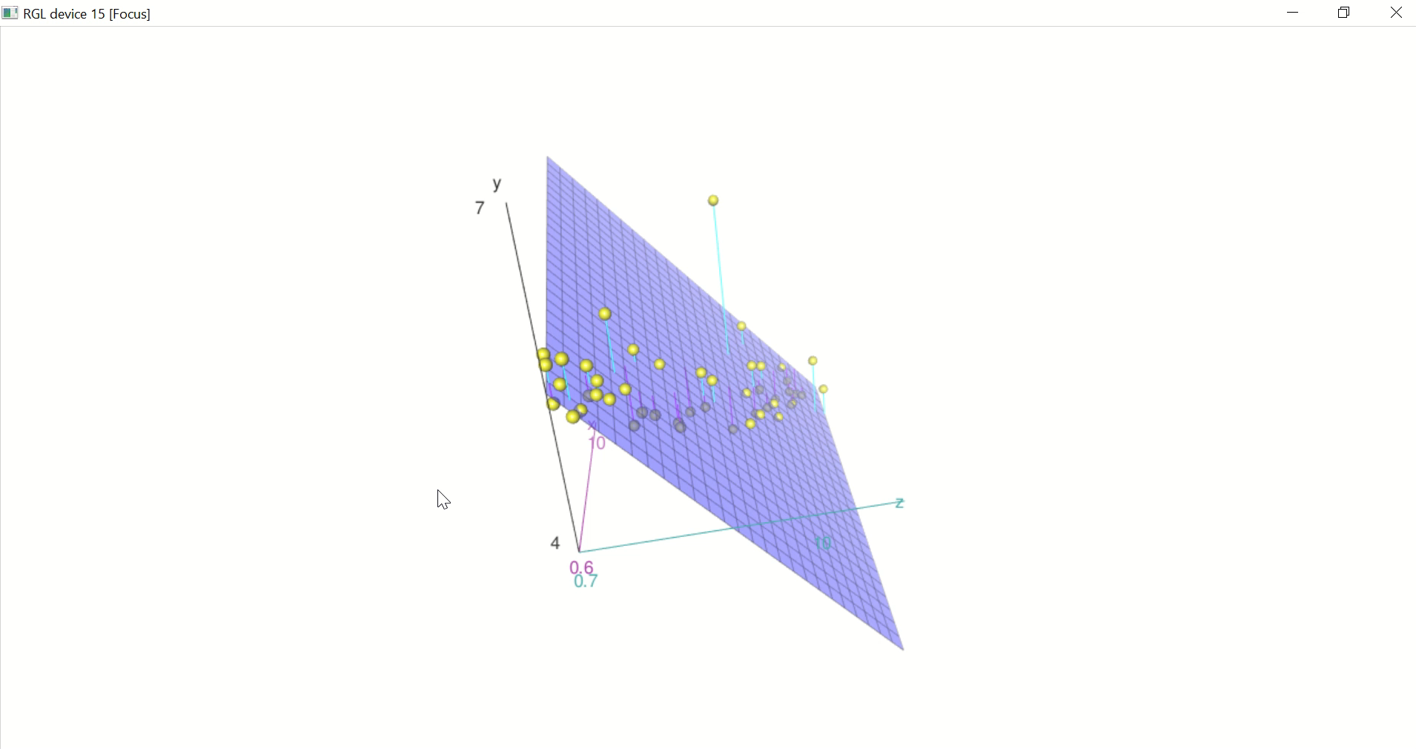
So this is our output an interactive RGL device but it’s quite hard to read currently !
But we can see there’s an outlier that wouldn’t of been spotted in a 2D graph

Slide 33
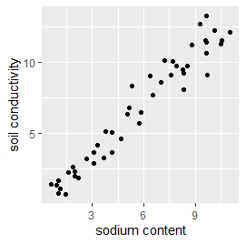
If we just plotted sodium content vs conductivity our outlier is lost and wouldn’t be detected.
This plot isn’t capturing that soil pH also effects conductivity

Slide 34
Customizing
We haven’t got any labels currently so add some x, y and z labels to you plot:
scatter3d(x, y, z, xlab=“any name”, ylab=“any name”, zlab=“any name”)
Lets get rid of the surface plot currently intersecting our graph :
scatter3d(x, y, z, surface= FALSE)

Slide 35
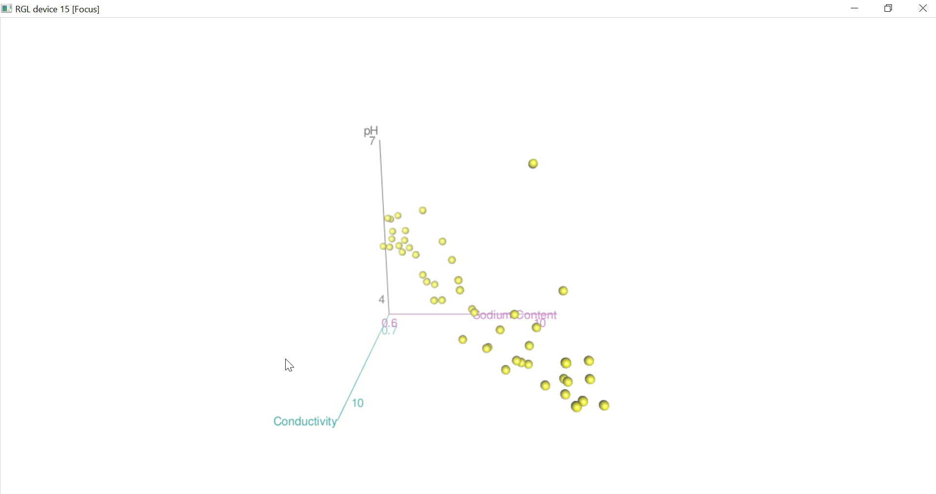
Much better !
You can read the documentation here to find out more about 3D graphs with rgl :
http://www.sthda.com/english/wiki/scatterplot3d-3d-graphics-r-software-and-data-visualization

Slide 36
Thank You !

Slide 37
Resources
As stated in session one, there are many ways to access resources on the tidyverse:
Stack Overflow is a great resource
Simply web-searching your problem followed by one of 'R', 'Tidyverse', or the specific tidyverse package you are using will return you many helpful guides
The tidyverse has a website with help guides, tutorials, and full documentation
You can also check out the cheat sheets for each of the packages we’re found in the files channel
Best of luck!

